Slide 1
EQIP incentives to implement water quality BMPs
HOW can Natural Resources Conservation Service (NRCS) help Local producers?

Slide 2
Protecting water quality with BMPS
Best management practices, or BMPs, are recommended structures, methods, and practices designed to protect water quality. BMPs can provide environmental, agronomic, and economic benefits.
Every farm is unique and requires a particular combination of practices that meet the needs of the land and the producer.

Slide 3
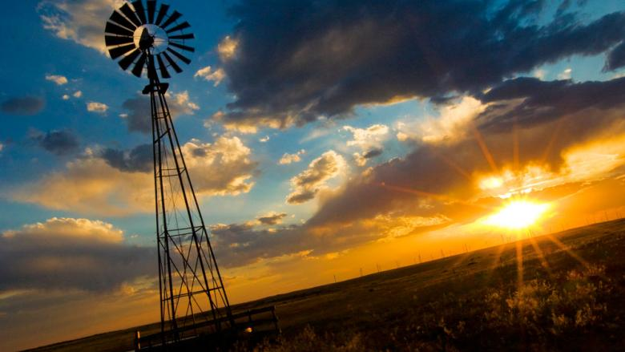
Nutrient pollution comes from a variety of sources including wastewater, urban stormwater, landscape runoff, and agriculture.

Slide 4
WHAT HELP IS AVAILABLE FOR PRODUCERS TO ADOPT BMPS?
The Natural Resources Conservation Service (NRCS) offers technical and financial assistance.

Slide 5
Nutrient & Fertilizer Management Facts
Nitrogen is the nutrient that most frequently limits irrigated crop production in Colorado.
The nitrate (NO3– ) form of nitrogen fertilizer is extremely soluble and subject to runoff and leaching losses.
Phosphorus in most Colorado soils is tightly held to soil particles and may contaminate surface water through soil erosion in runoff.
Organic forms of phosphorus found in humus, manure, and crop residues tend to be more soluble.

Slide 6
General Nutrient Management BMPs
A nutrient management plan should serve as the foundation for meeting crop nutrient needs
•Develop a yearly fertilizer plan for each field and crop.
•Test soil, plant tissues, and irrigation water.
•Analyze and credit nutrients from manure, compost, and biosolids.
•Establish realistic crop yield expectations.
•Keep fertilizer records.
•You can Utilize a crop consultant
•Manage irrigation application to avoid nutrient runoff and Soil leaching.

Slide 7
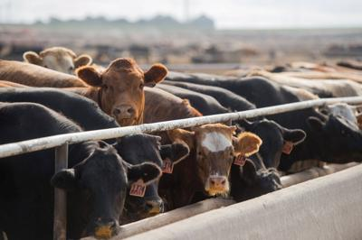
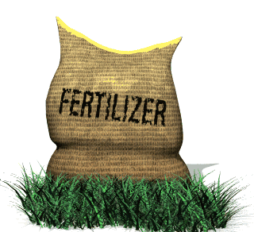
NUTRIENT MANAGEMENT
CODE 102
CODE 104
CODE 590
Comprehensive Nutrient Management Plan - Written
In 2019
HU-Livestock Operation Greater Than 300 AU without Land Application
$8,553.36
Nutrient Management Plan - Written
CAP Plan
In 2019
HU-Nutrient Management CAP Greater Than 300 Acres (Not part of a CNMP)
$3,592.42
Nutrient Management
In 2019
HU-Basic NM (Non-Organic/Organic)
$7.05 per acres

Slide 8
Irrigation Management
Proper irrigation management provides adequate moisture to crops while helping keep water, soil sediments, and nutrients in the field.
Nitrate-nitrogen (NO3– – N) from fertilizer is extremely soluble and moves readily with irrigation water.
Phosphorus is relatively insoluble in water but is attached to soil sediments that may be carried away by irrigation water.

Slide 9
Irrigation Water Management (IWM) CODE 449
Basic
Intermediate
Advanced
Basic IWM <= 30 acres $19.60 AC
HU-Basic IWM <= 30 acres $28.51 AC
Basic IWM > 30 acres $7.06 AC
HU-Basic IWM > 30 acres $10.28 AC
Intermediate IWM <= 30 acre $26.13
HU-Intermediate IWM <= 30 acres $38.01
Intermediate IWM > 30 acres $9.03
HU-Intermediate IWM > 30 acres $13.13
Advanced IWM <= 30 acres $32.67
HU-Advanced IWM <= 30 acres $47.52
Advanced IWM > 30 acres $10.99
HU-Advanced IWM > 30 acres $15.99

Slide 10
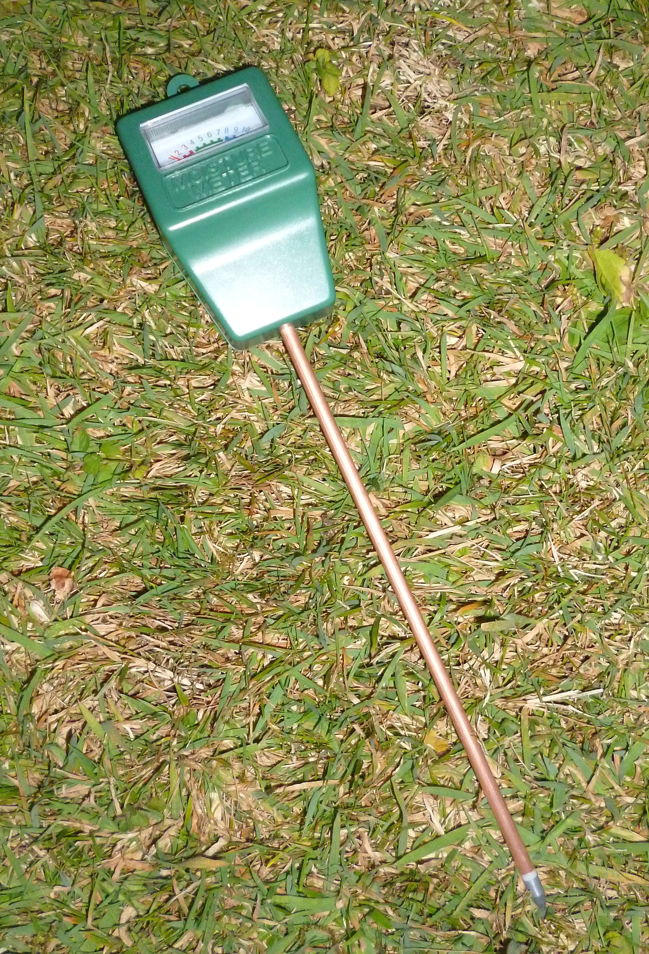
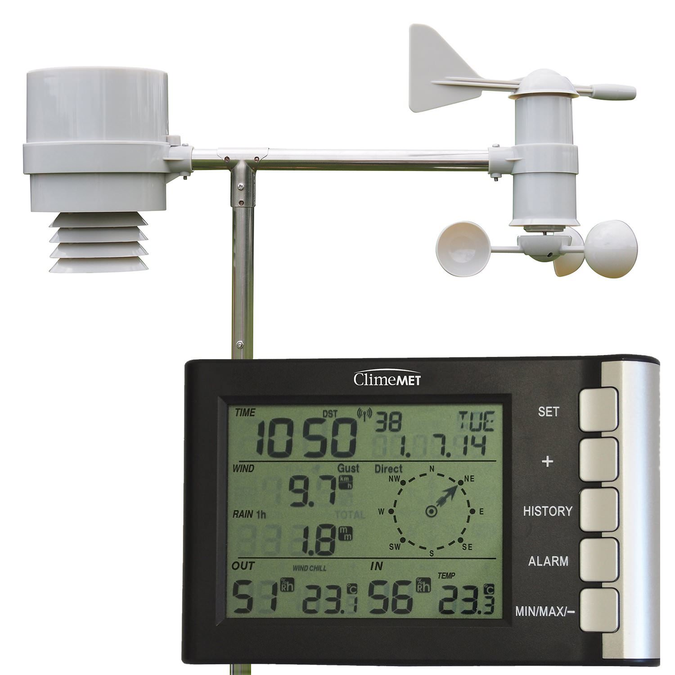
IWM Tools
Soil Moister Sensors
Soil Moister Sensors with Data Loggers
Advanced Weather Station and Soil Moisture Sensors
Upgrade Your Current Irrigation system
Upgrade Earthen Ditches
This Photo by Unknown Author is licensed under CC BY-SA-NC

Slide 11
Soil & Erosion Management
Soil erosion can impact water quality by transporting soil sediments and the attached nutrients and chemicals into surface waterways. Soil erosion also results in the loss of fertile topsoil and reduces cropland productivity.
Utilizing better tillage and residue management practices can improve soil structure to more efficiently use nutrients and water.
Creating better Soil health, also referred to as soil quality, is defined as the continued capacity of soil to function as a vital living ecosystem that sustains plants, animals, and humans. This definition speaks to the importance of managing soils so they are sustainable for future generations.

Slide 12
What's In our tool Box for Soil Erosion
Grazing Management Plan
Conservation Cover
Conservation Crop Rotation
Residue and Tillage Management, No-Till
Contour Farming
Contour Buffer Strips
Cover Crop
Critical Area Planting
Windbreak/Shelterbelt Establishment
Field Border
Riparian Forest Buffer
Filter Strip
Grassed Waterway
Anionic Polyacrylamide (PAM) Application
Range Planting
Wetland Restoration
This Photo by Unknown Author is licensed under CC BY

Slide 13
Healthy soils hold more available water. The soil’s water-holding capacity reduces runoff that can cause flooding, and increases the availability of water to plants during droughts. Good infiltration and less need for fertilizers and pesticides keep nutrients and sediment from loading into lakes, rivers, and streams. Groundwater is also protected because there is less leaching from healthy soils. Additionally, fewer trips across fields with farm machinery mean fewer emissions and better air quality.

Slide 14
Manure Management
Livestock manure is rich in plant nutrients. Manure that is properly applied increases soil fertility and may also improve soil physical properties.
01
Improperly applied manure can contaminate surface water and groundwater.
02
Producers must select the relevant best management practices for their crops and land to both maximize nutrient efficiency and protect water quality.
03

Slide 15
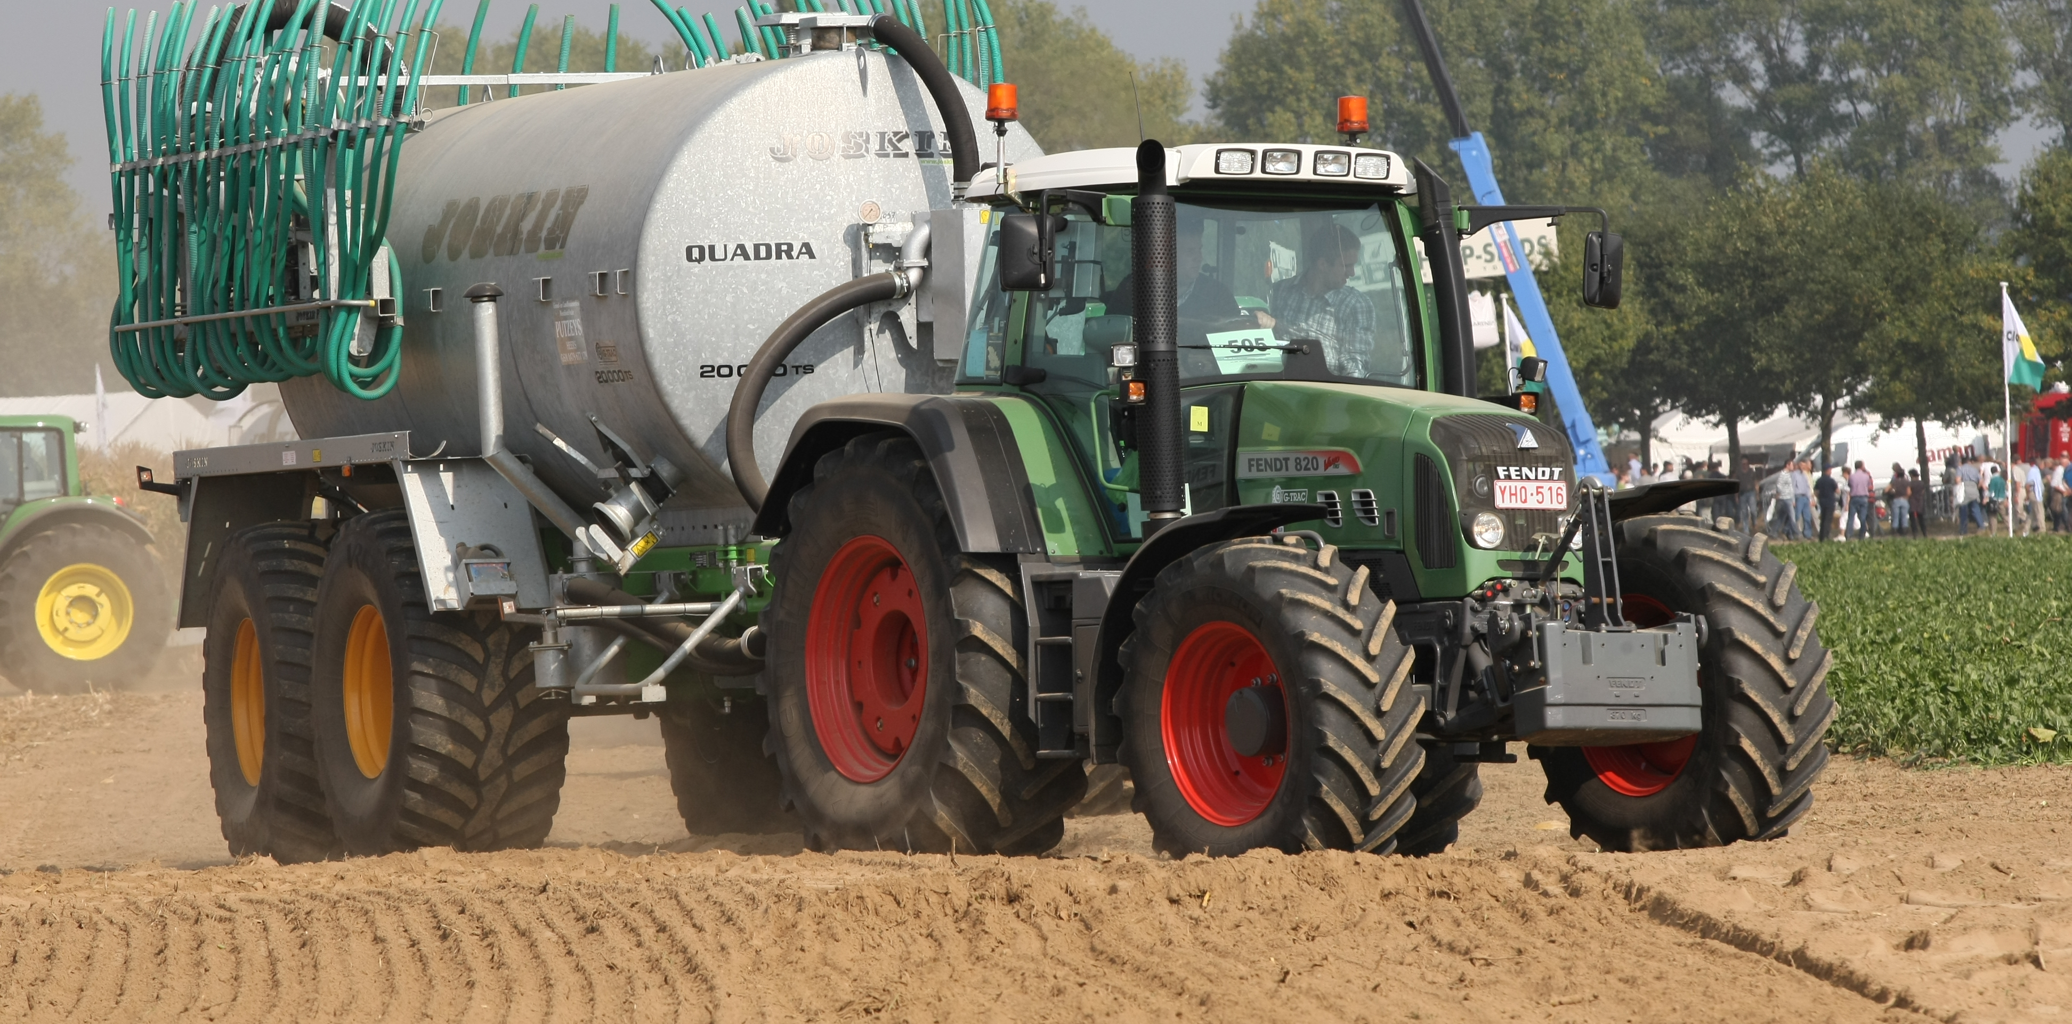
Waste Management Systems: a variety Of practices
This Photo by Unknown Author is licensed under CC BY-SA

Slide 16
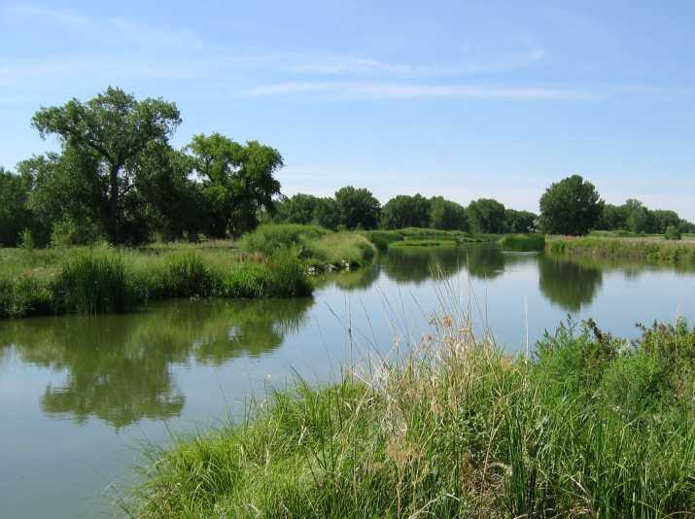
Wetland Development or Restoration Wetlands are a key link in watershed management. The role that they play in our watersheds is critical to protecting water quality
South Platte River
Wetlands can help improve water quality by removing or retaining nutrients, organics,
and sediment carried by runoff. The flow of water slows as it enters a wetland,
which causes sediment in the water to settle out. Many chemicals — fertilizers,
human and household wastes, toxic compounds —are tied to sediment and
trapped in wetlands. Plants and the biological processes present in a wetland
breakdown and convert these pollutants into less harmful substances.

Slide 17
Together, NRCS and producers invest in solutions that conserve natural resources for the future while also improving agricultural operations. Through EQIP, NRCS provides agricultural producers with financial resources and one-on-one help to plan and implement improvements, or what NRCS calls conservation practices. Your local district conservationist and staff will help producers navigate the application process and begin to develop a conservation plan.

