Slide 1
Power of Collaboratives for Water Resilience Case Study: Aurora, CO
Gretel Follingstad
gretelfollingstad@gmail.com
PhD Candidate/Instructor University of Colorado
Senior Water Planner, Terra Planning, LLC

Slide 2
This study looked at the collaboratives agreements the Aurora Water has engaged in from 2010-2019 as a means for securing water adequacy for growth and sustainability

Slide 3
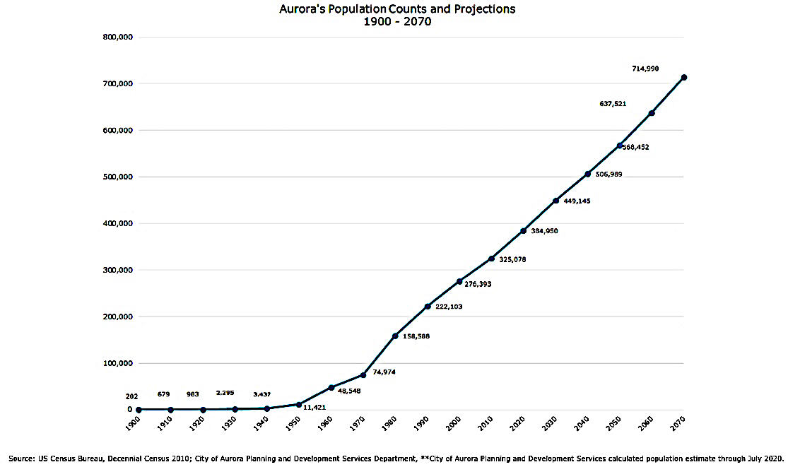
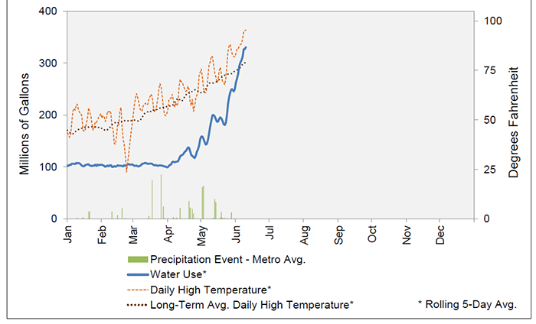
City of Aurora, CO
Denver metro area of Colorado’s front range.
Facing intense growth and development pressures and is working to secure the water supply needed for that growth.
Newer city (compared to Denver) predominantly holds junior water rights, which leaves the community vulnerable to priority calls in times of drought
Notes:
Figure 6. Seasonal Outdoor Irrigation Norms – Denver, CO

Slide 4
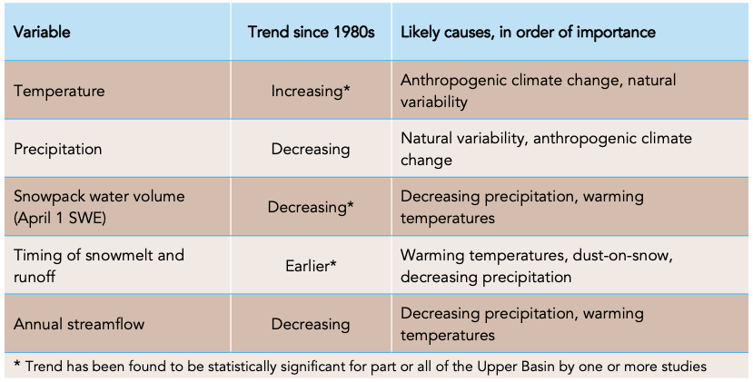
Summary of Upper Colorado Basin Hydroclimate Trends (Lukas & Payton, 2020)

Slide 5
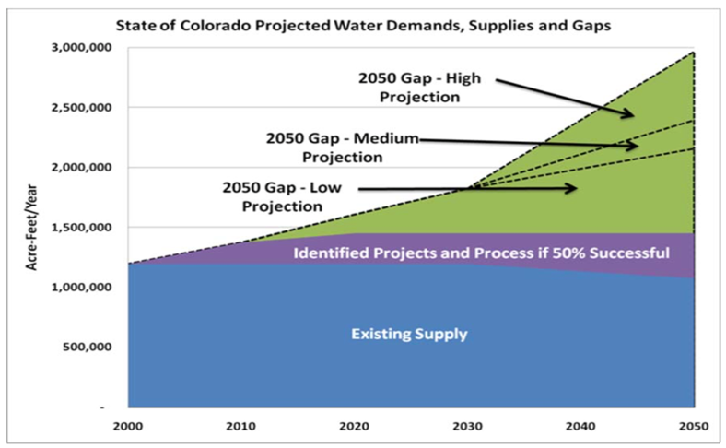
Colorado’s Projected Water Supply and Demand Gaps. Source: Colorado Department of Natural Resources

Slide 6
Power of Collaboratives for Water Resilience

Slide 7
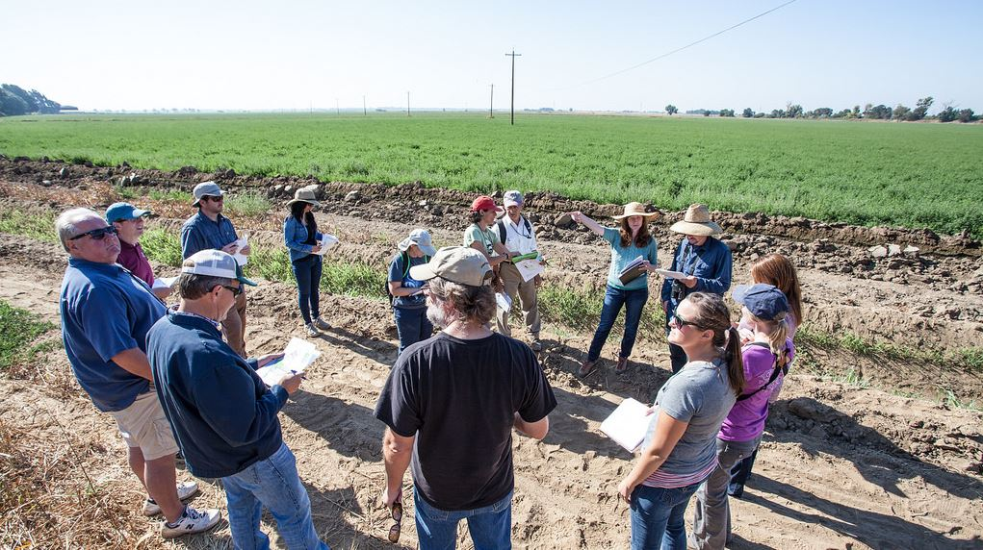
Characteristics of Collaboration/Partnerships
Wide range of stakeholders representing different organizations, interest groups, and affected citizens
Engagement in process
Goal: consensus on problems, goals, actions
Collaborative exhibits a commitment to problem solving
May focus on direct actions (e.g., management issues) and/or policies

Slide 8
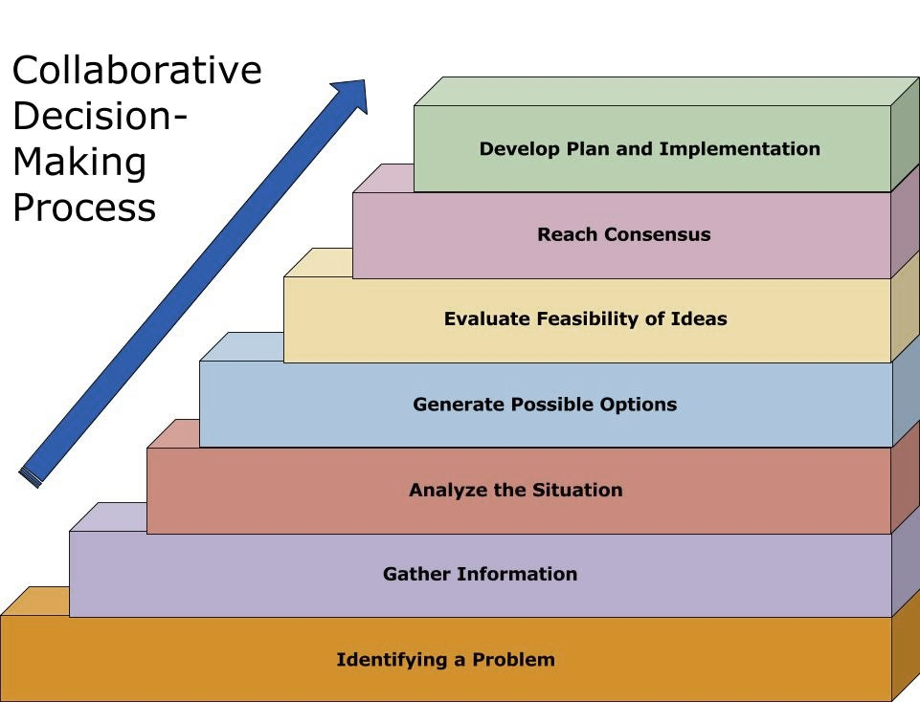
Collaborative processes aim to:
Construct greater competence in resource sharing,
Foster positive rapport among stakeholders
Create innovative solutions to governance challenges
Notes:
From my experience, where formal collaborative efforts first go awry is thinking that all we need to do is get in a room and follow a rationale planning model. They start off very task oriented. I get it….it seems so easy.
Identify a problem
Learn more about the issues
Brainstorm solutions
Test their feasibility
Then Boom! You have consensus!
This logical progression gets pretty messy, pretty quick!

Slide 9
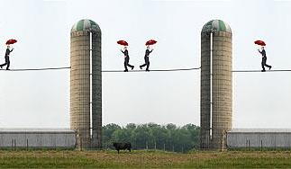
Collaborative Partnerships: Building Consensus through common ground
Cross Sector Collaboration
Multi-disciplinary teams (including regulatory agencies) working together to build solutions, initiates recognition of the interrelationships and inspires new creative approaches.

Slide 10
Goals
Improve
Improve policy or program through partnership
Improve
Improve Capacity of agency or systems (natural or infrastructural)
Adapt
Adapt to changing circumstances

Slide 11
Collaboratives bring stakeholders together to work toward win-win policy solutions by integrating economic & environmental goals and focusing on local participants (Klyza & Sousa, p. 212).
Innovation
Diffusion
Adaptation
Notes:
Innovate new approach
Diffuse vulnerability or threat or issue
Adapt to all needs and new circumstances

Slide 12
Procedural, Substantive, Practical Tests
Procedural: inclusive & responsible participation in the decision process that serves the common interest
Substantive: the common interest depends on the valid and appropriate interests of community members
Practical: in practice the common interest depends on experience (outcomes) that support the expectations of goals
Notes:
Are participants representative of the policy community, responsible & accountable?
Evaluate the experience/outcomes:
Where are opportunities to make participation more inclusive & responsible to the broader community?
What interests are no longer valid or appropriate?
What new interests should be integrated into future policies?

Slide 13
Climate Resilience Framework (CRF) for Water Adequacy & Resilience
Logic Model

Slide 14
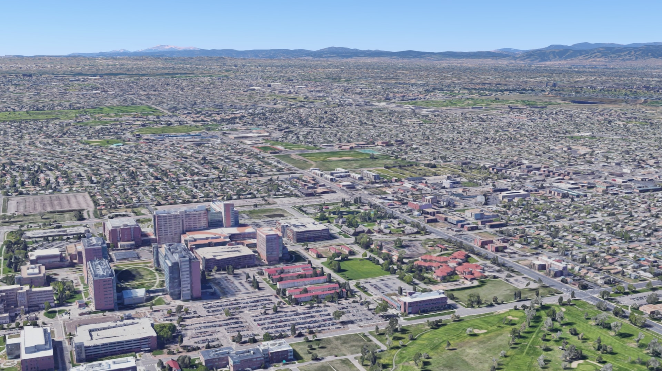
Assessing Aurora Water Collaboratives & Cooperatives
Climate Resilience Framework (CRF)
Illustration of Systems Resilience
Flexibility and diversity
Redundancy and modularity
Safe failure
Illustration of Agent Capacities Resilience
Responsiveness
Resourcefulness
Capacity to learn
Characteristics of Institutional Resilience
Rights and entitlements
Decision making
Information
Application of new knowledge

Slide 15
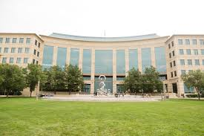
549 Government Agreements Coded
Three primary categories
Systems,
Agent Capacities and
Characteristics of Institutions,
Notes:
In addition, documents will be coded for three key terms, Resilience, Adaptation and Collaboration and assessed based on the following table.

Slide 16
Types of Collaboratives

Slide 17
Water Systems: Percent of Total Annual Agreements

Slide 18
Water Supply Adequacy - % of Total Agreements

Slide 19
Areas of Capacity Building
Notes:
Blue- No
Orange- Planning
Grey- Program
Yellow– Policy
Blue- Physical
Green Other

Slide 20
Range of Financial Capacity Building
Pooling Resources
Sharing Cost
Loans
Taxes / Bond Measure
Rates
Payment for Water Rights
Water Lease Fees
Fee for Service
Project Costs
Grants / Donations
Collaborator/ Partner(s) Pay
Aurora Pays Project Fees
Liability of Damage
Other

Slide 21
Range of Financial Capacity Building

Slide 22
Agency Agility to Changing Conditions
Notes:
Changes in Agreement due to Ownership Ability to meet Agumentation Requirements Well Draw Down River System Needs 2012 Undefined Planning for Flood Hazard 2019 Population Growth

Slide 23
Water Utility Services / Programs Capacity

Slide 24
Next Steps……
Deeper dive into the data to determine Aurora’s levels of resilience
This will include assessments of other communities that have used the Climate Resilience Framework for Water Sustainability and Resilience

